Slide 1
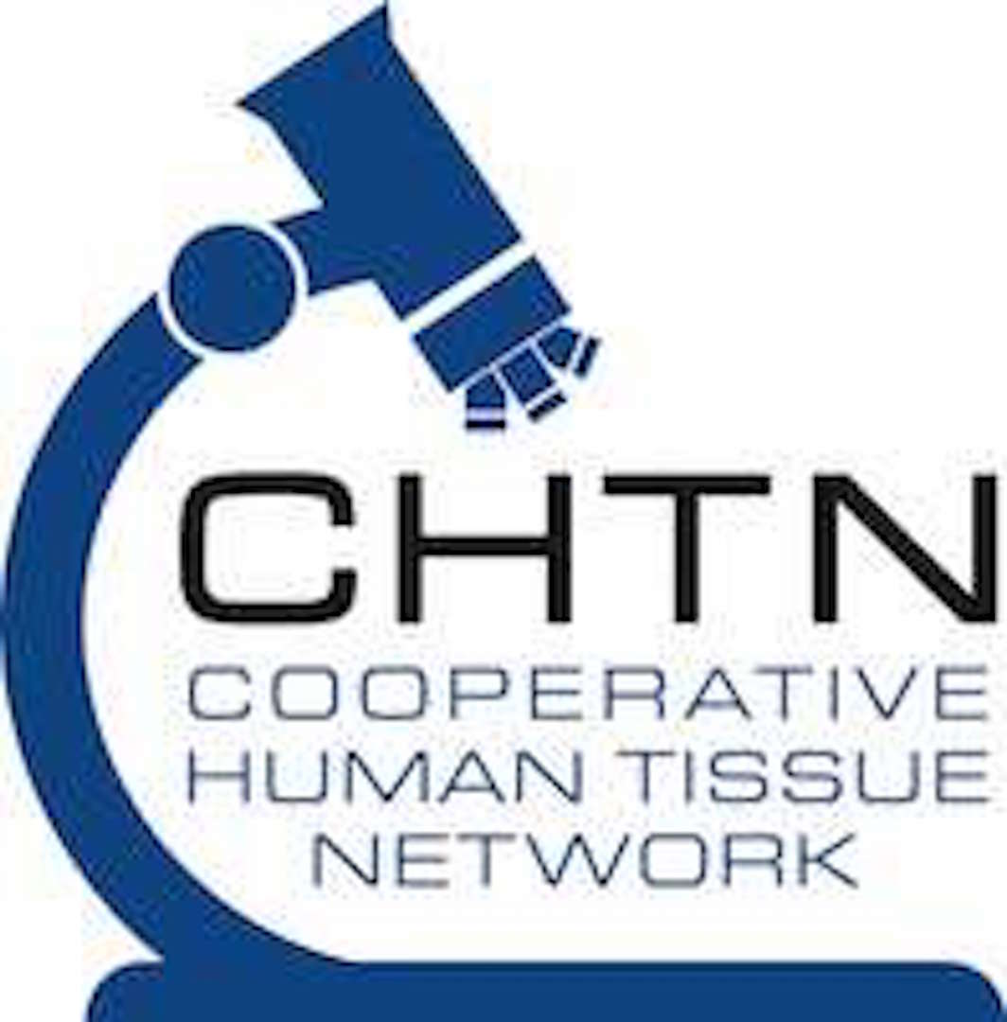
NIH〉
Acknowledgment slide
CHTN’s RRID: SCR_004446
www.chtn.org
Supporting your discoveries since 1987
Biospecimens were provided by the NCI funded Cooperative Human Tissue Network (CHTN). Other investigators may have received specimens from the same tissue specimens.
The CHTN is comprised of six academic institutions who collect and distribute remnant human biospecimens from routine surgical and autopsy procedures to investigators for basic and applied science to advance biomedical research.
CHTN Eastern Division: University of Pennsylvania CHTN Pediatric Division: Nationwide Children’s Hospital
CHTN Mid-Atlantic Division: University of Virginia CHTN Southern Division: Duke University
CHTN Midwestern Division: The Ohio State University CHTN Western Division: Vanderbilt University Medical Center
An NCI Sponsored Resource

